Slide 1
Comparison Study of different ML/DL approach on Twitter Sentiment Analysis
Md Asaduzzaman Jabin
Graduate Student
School of Electrical and Computer Engineering
University of Georgia, GA-30602
Email: mj71006@uga.edu

Slide 2
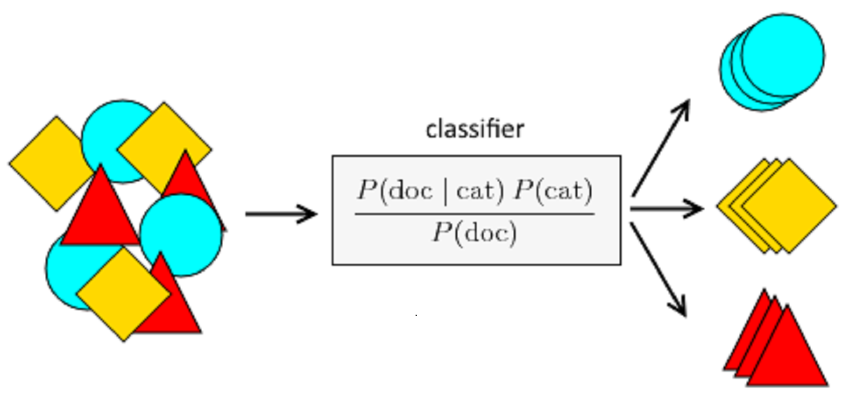
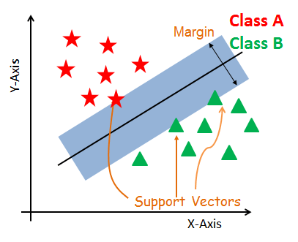
Introduction
Research Question
People’s opinion about the PM election campaign of a certain candidate
Twitter Sentiment Analysis
Comparison Study:
a) Machine Learning- SVM, Naive Bayes
b) Deep Learning- LSTM
1. Access and Load data
2. Preprocess
Data Set
3. Derive Features
Kaggle Twitter Data Set- Prime Minister Election (Ref. 1)
Size- Number of tweets: 162K
Sentiment Class/ Data Labeling: Negative(-1), Neutral(0), and Positive(+1)
Class Distribution: Negative(23%), Neutral(33%), and Positive(44%)
Attributes: 2 , clean_text (string), category (numeric)
4. Model Training
5. Model Tuning
6. Result
Workflow
Data : https://www.kaggle.com/code/subhadeepdebnath/twitter-sentiment-analysis-lstm-complete-guide/data
Code Reference 1: https://github.com/soham2707/Twitter-Sentiment-Analysis-
Code Reference 2: https://www.kaggle.com/code/moathmohamed/twitter-sentiment-lstm-98

Slide 3
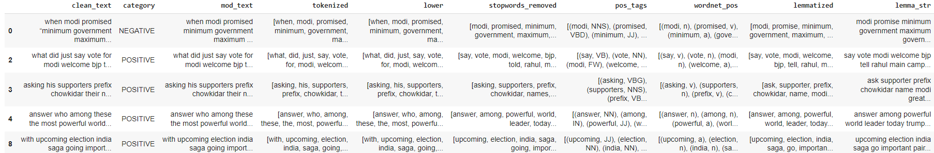
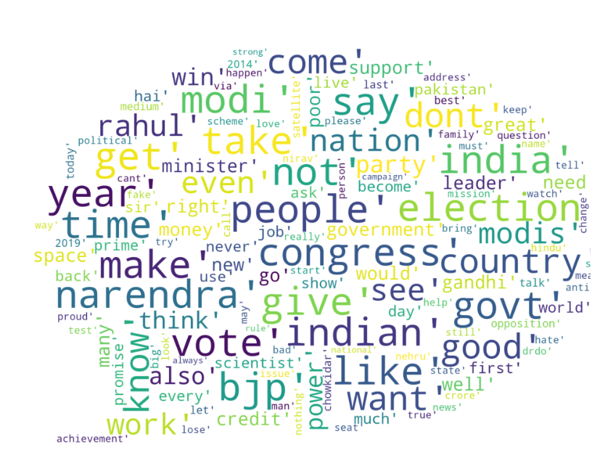
How NLP Processing works
Tokenized
Lower Case Conversion
Train Set
Apply parts of the speech tag
Word Lemmatize
Mapped Sentiment
Cleaned Data
Removed unwanted words

Slide 4
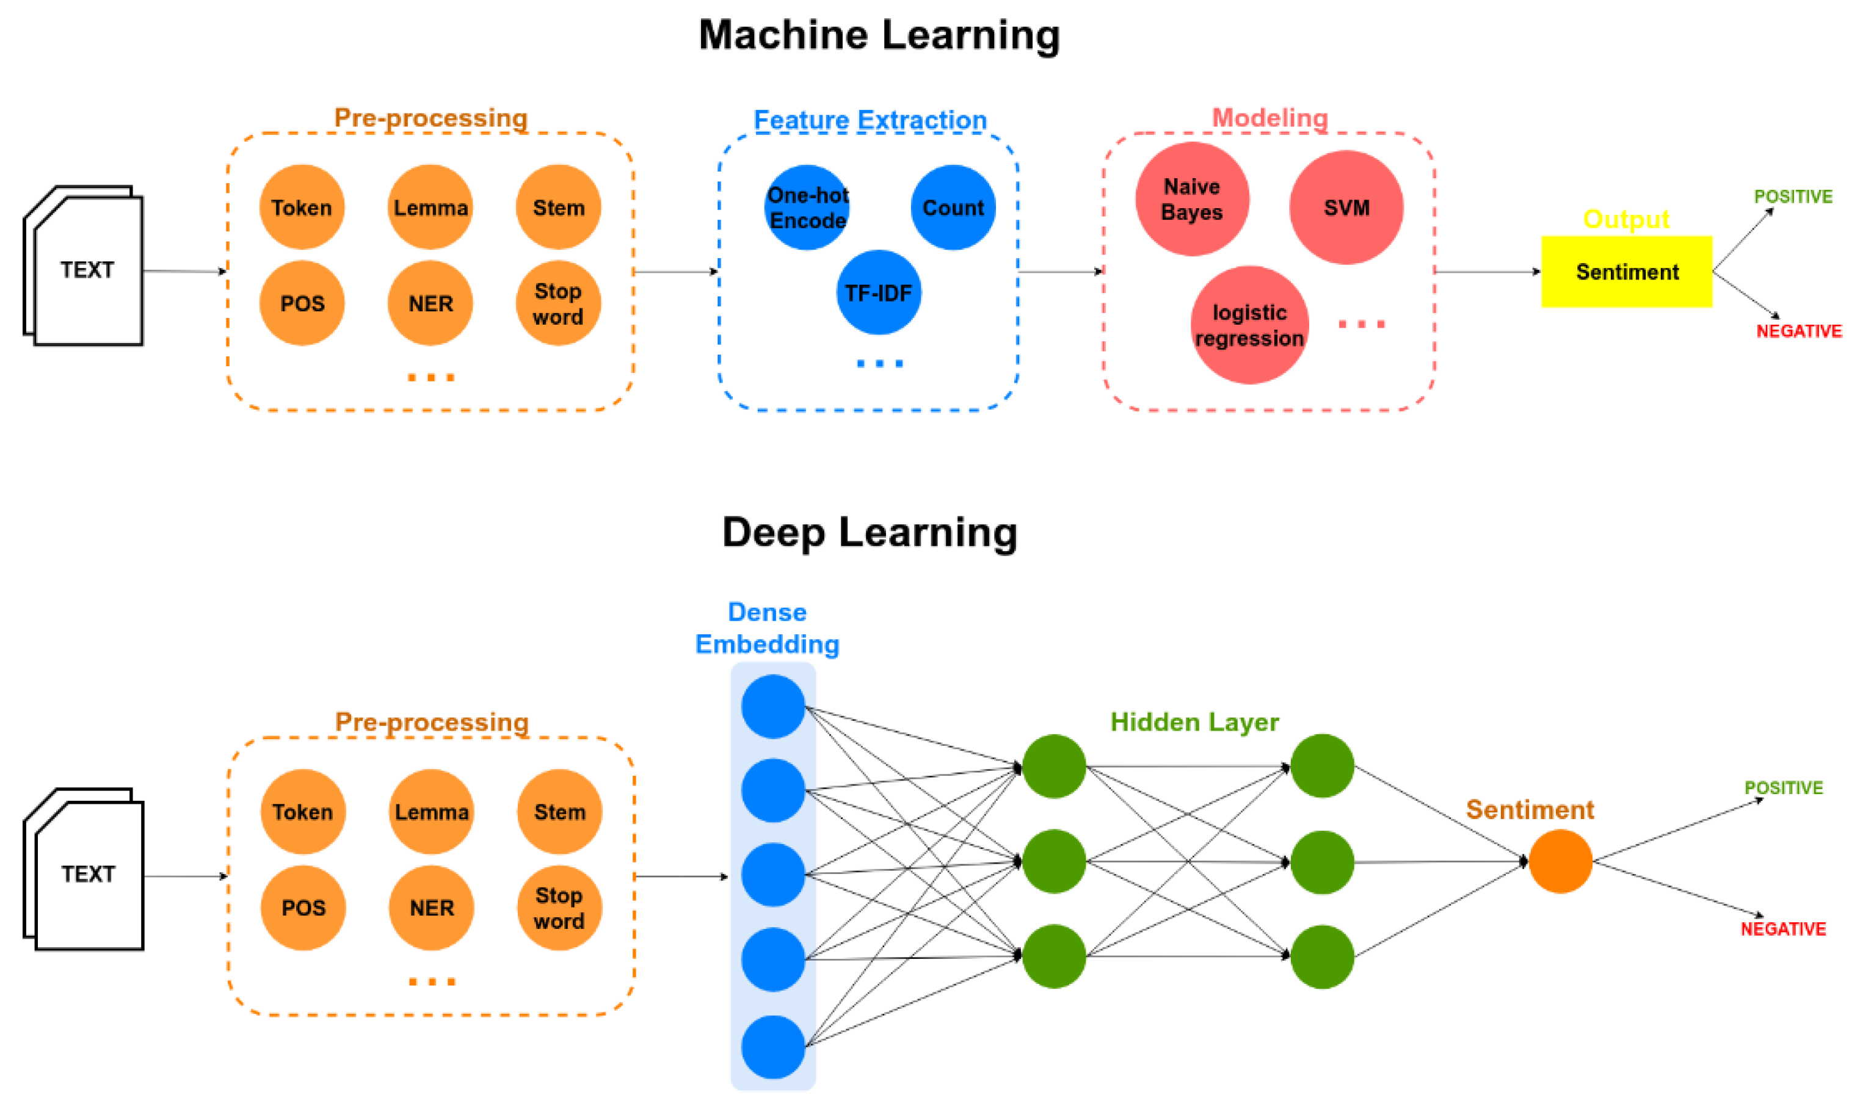
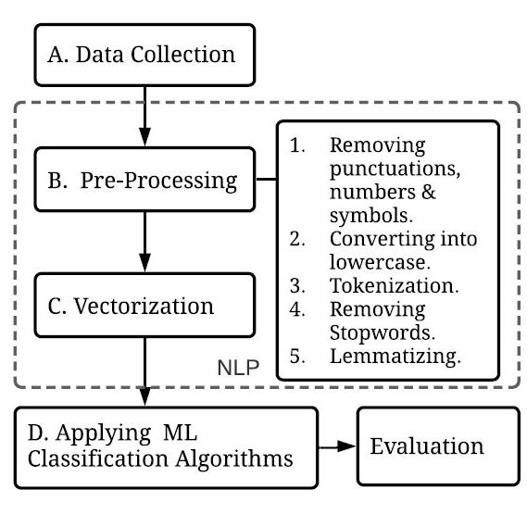
Model Architecture: NLP
(a)
(b)
Neutral
Neutral
Bi-LSTM

Slide 5
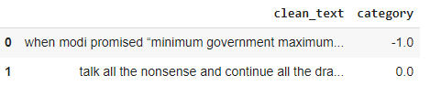
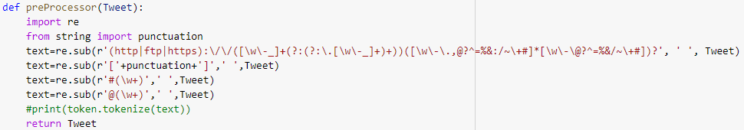
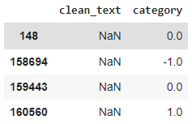


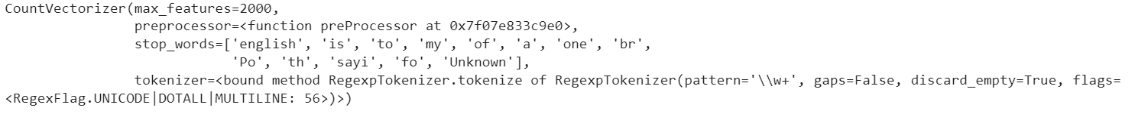

ML Workflow
1. Access and Load data
3. Derive Features: Apply helper function
Text Manipulation and Cleaning
Remove URLs, HTML tags, punctuation marks, quotes, email address
2. Preprocess
a) Drop missing/ duplicate data
b) Word Lemmatization: Text feature Extraction
To extract expression words from the text
b) Map Sentiment Category
1)
2) TfidfVectorizer(), HashingVectorizer
c) Check distribution
Negative(23%), Neutral(33%), and Positive(44%)
Code Reference: https://github.com/soham2707/Twitter-Sentiment-Analysis-/blob/master/tweet_sentiment.ipynb

Slide 6
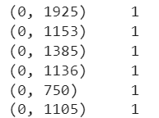
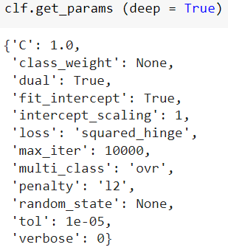
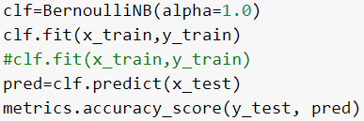
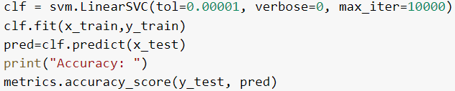

Workflow: Machine Learning (Naïve Bayes, SVM)
Code Reference: https://github.com/soham2707/Twitter-Sentiment-Analysis-
c) Feature Scaling (Compute the mean and std dev for a given feature to be used further for scaling)
3. Train a model
b) K fold Cross validation
a) Split the data into train, validation, and test
(40%, 40%, 20%)
c) Select the model (Naïve Bayes, SVM)
4. Tuned model
SVM
Naïve Bayes
Notes:
how much you want to avoid misclassifying each training example

Slide 7







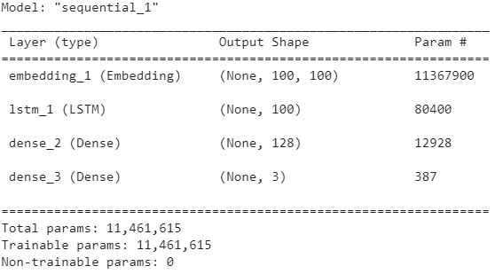
Workflow: Deep Learning (Bi-LSTM)
All the Preprocessing (1-2) derived from ML parts (slide 5)
Code Reference 2: https://www.kaggle.com/code/moathmohamed/twitter-sentiment-lstm-98
3. Derive Features: Apply helper function
b) Ensure all sequence padding with same length
Text Manipulation and Cleaning
Extract feature tokenizer and convert string to int sequence for time sequence
described in slide 3
c) Bi-LSTM Train
Unique Lemma words =113678
100 nodes
128 →98% accuracy
b) Applying mask on each sentiment to achieve time series
3 →98% accuracy
2. categorical_crossentropy
3. Train a model
a) Split train, validation, and Test : 40%, 40% ,20%

Slide 8

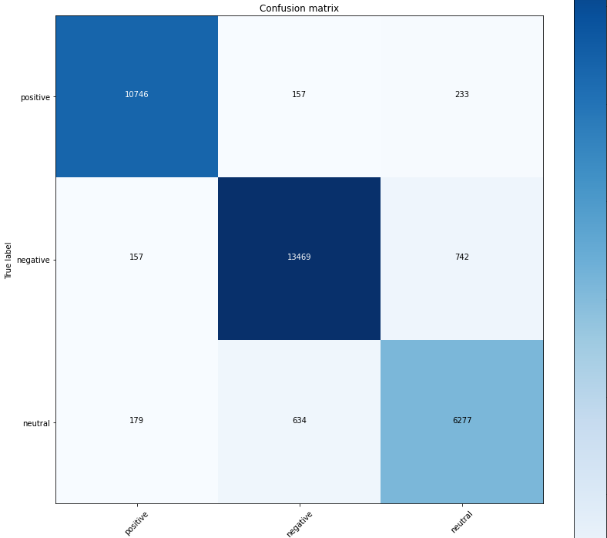
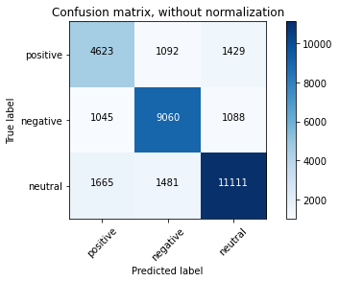
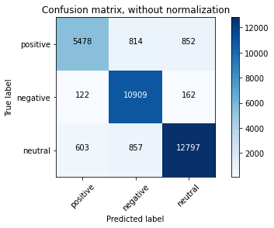
Result: Comparison Study: Best Accuracy Between ML and DL for twitter sentiment
Naïve Bayes
SVM
Bi-LSTM
Base Line Accuracy: 70.25%
Base Line Accuracy: 81.47%
Base Line Accuracy: 64.07%
Runtime: 6 seconds
Runtime: 600 seconds
Runtime: 14400 seconds
Current Accuracy: 75.52%
Current Accuracy: 89.23%
Current Accuracy: 93.55%
Runtime: 7 seconds
Corresponding code link: https://colab.research.google.com/drive/1Ghc0IgW7HIeUPfO5UTYX7yXxLXzk7rS9?usp=sharing

Slide 9
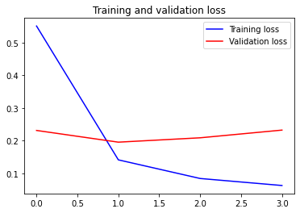
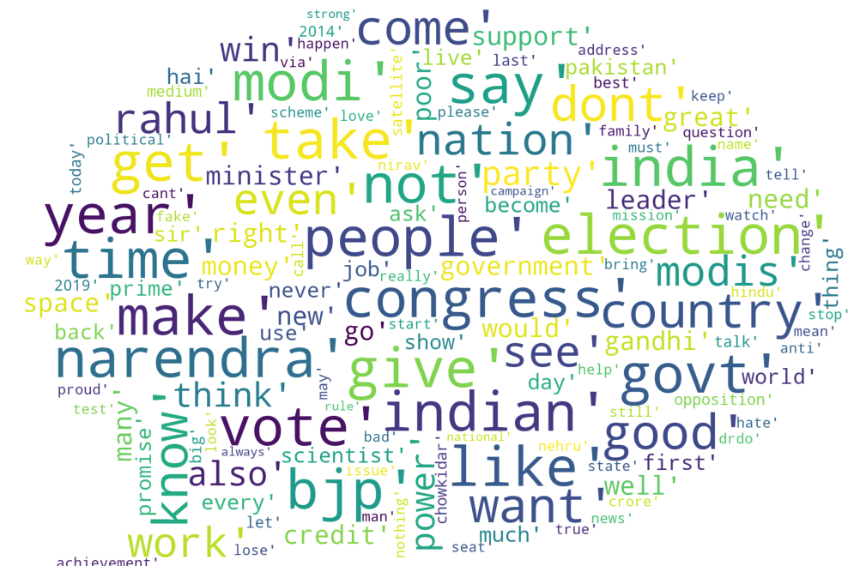
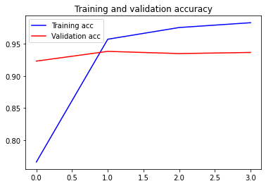
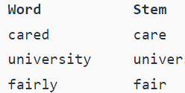
More Data Form DL Training : Bi-LSTM
Bi LSTM
Word cloud
Word stemmer
The loss and accuracy trends for the highest accurate model (Bi-LSTM 93% testing accuracy)

Slide 10

Summary
Data: 40%, 40%, 20% → train, validation, test
Overall test Accuracy → Bi LSTM gives 93% > SVM (89%) > Naïve Bayes (75%)
For Deep learning→ each layer of Bi-LSTM
Test 1: On baseline code (code reference – page 2) we used Dense(256) nodes to give 75% accuracy with the changed data set (Equal sentiment distribution – 33% on each sentiment (positive, neutral, negative)).
Test 2: Dense(64) come up with 72%
Test 3: Dense (125) come up with 93%
For Machine Learning
SVM →
Test 1: On baseline code (code reference – page 2) gives for TfidfVectorizer with 73% accuracy, with the changed data set (Equal sentiment distribution – 33% on each sentiment (positive, neutral, negative)).
Test 2: HashingVectorizer gives 63% accuracy
Test 3: Based on Countvectorizer got an accuracy of 89% (alpha = 1.0, L2 regularize, Tolerance 1e-5)
Naïve Bayes →
Test 1: Baseline code (code reference – page 2) with the changed data set (Equal sentiment distribution – 33% on each sentiment (positive, neutral, negative)) gives 69% accuracy for (alpha =2.0, 5 fold cross validation)
Test 2: For changed parameters (alpha =1.0, 10 fold) it gives 75.52% accuracy

Slide 11
Future Plan
Check more deep learning – GRU Algorithm performance
Check optimization and targeted accuracy is >90% for Roberta Algorithm
Thank You !

